Slide 1

CS+Social Good
CS 106S Winter 2018

Slide 2





introductions
why section?
class info
javascript tutorial
hi!!!!11!1!
we are so excited to meet you!
Ashi Agrawal
Stanford ‘19
ashia@stanford.edu
Ryan Cohen
Stanford ‘19
rrcohen@stanford.edu
Kevin Khieu
Stanford ‘18
kkhieu@stanford.edu
Matthew Sun
Stanford ‘20
mattsun@stanford.edu

Slide 3
introductions
why section?
class info
javascript tutorial
Before we start…
INFO SESSION:
Tuesday, January 16th
7:00pm – 8:00pm
Old Union 215

Slide 4
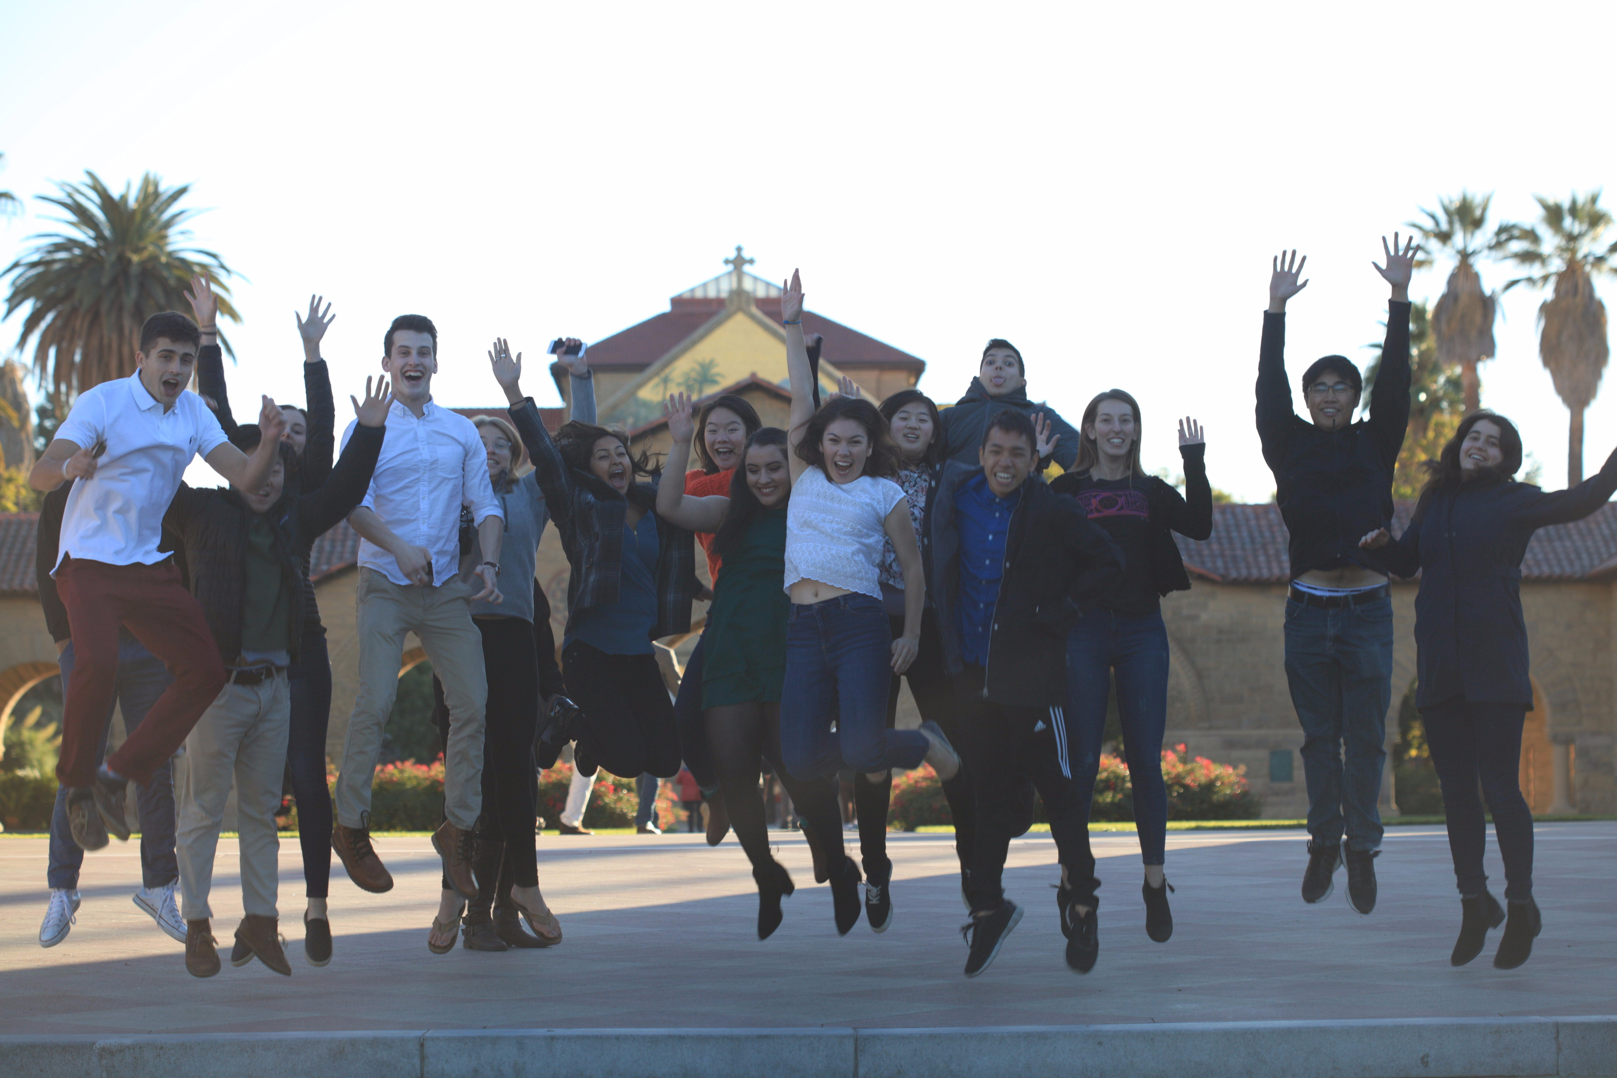


introductions
why section?
class info
javascript tutorial
why section? well why not, HUH????

Slide 5
introductions
why section?
class info
javascript tutorial
logistics
TIME
Thursdays, 4:30 – 6:20 PM
LOCATION
Littlefield 107
DURATION
10 weeks
CREDIT/GRADING
1 unit, Pass/Fail
GRADING
Attendance (≥9/10)
Checkoff forms
Final reflections
TEAM
Ashi Agrawal, Ryan Cohen
Kevin Khieu, Matthew Sun
Bring your laptops to every class!

Slide 6
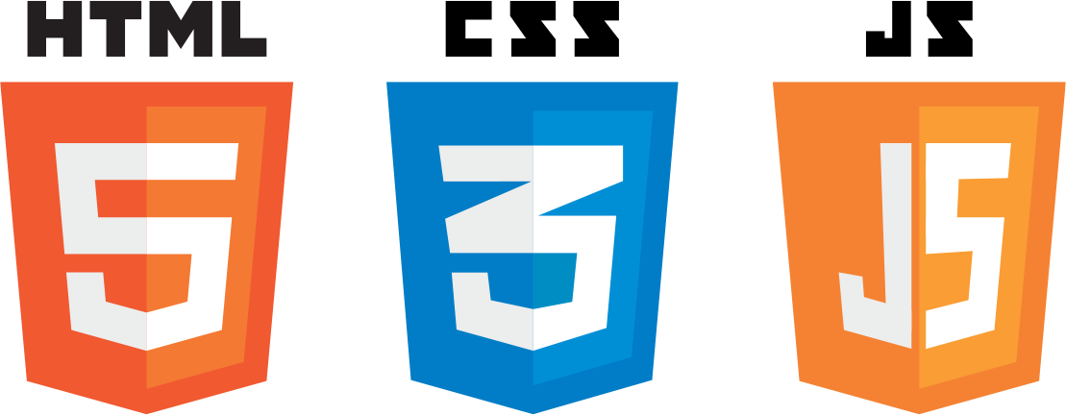

introductions
why section?
class info
javascript tutorial
the good stuff!
WEB DEV
JavaScript
Notes:
js, html, & css are the main building blocks of every website/webapp. you can think of these different technologies as having three different roles: javascript is for controlling the dynamic behavior of the website, and is similar to python or java. html, or hypertext markup language, is a language for specifying the general structure of the website (for example, a header, then three paragraphs of text, two images, then a footer). css, which stands for cascading style sheets, is used to style the different elements to make the website look pretty.

Slide 7
introductions
why section?
class info
javascript tutorial
the good stuff!
WEB DEV
JavaScript
we’ll use this!
Notes:
js, html, & css are the main building blocks of every website/webapp. you can think of these different technologies as having three different roles: javascript is for controlling the dynamic behavior of the website, and is similar to python or java. html, or hypertext markup language, is a language for specifying the general structure of the website (for example, a header, then three paragraphs of text, two images, then a footer). css, which stands for cascading style sheets, is used to style the different elements to make the website look pretty.

Slide 8
introductions
why section?
class info
javascript tutorial
the good stuff!
FROM WIKIPEDIA:
high-level, dynamic, untyped, and interpreted programming language
prototype-based with first-class functions
supports object-oriented programming
JavaScript
Notes:
high-level: a strong level of abstraction from the details of the computer (as opposed to machine language)
dynamic: at runtime, executes many instructions that are usually executed during compilation
interpreted: instructions executed directly, without compilation
untyped: doesn’t make you define the type of a variable
Prototype-based programming is a style of object-oriented programming where classes are not present, and behavior reuse (or inheritance in class-based languages) is performed by cloning existing objects that serve as prototypes.
First-class functions: functions can be stored in variables

Slide 9
introductions
why section?
class info
javascript tutorial
let’s program some stuff!
…but first, open
repl.it/languages/javascript

Slide 10
introductions
why section?
class info
javascript tutorial
JavaScript variables
var x; // dynamic typing
typeof x; // should print out ‘undefined’
x = 42; // typeof x == ‘number’
x = “CS106S rocks” // typeof x == ‘string’
x = true; // typeof x == ‘boolean’
Notes:
Variables have the type of the last thing assigned to it
Primitive types: undefined, number, string, boolean, function, object

Slide 11
introductions
why section?
class info
javascript tutorial
Variable Scoping
// Two scopes: global and function local
var globalVar;
function() {
var localVar;
if(globalVar > 0) {
var localVar2 = 2;
}
}
Notes:
Variables have the type of the last thing assigned to it
Primitive types: undefined, number, string, boolean, function, object

Slide 12
introductions
why section?
class info
javascript tutorial
Variable Scoping (cont.)
// All var statements hoisted to top of scope
function foo() {
var x;
x = 2;
}
function foo() {
x = 2;
var x;
}
Notes:
these are interchangeable

Slide 13
introductions
why section?
class info
javascript tutorial
number
no distinction between int and double
stored in floating point
Watch out! (0.1 + 0.2) == 0.3 is false
interesting: NaN, Infinity are numbers
1/0 == Infinity
Math.sqrt(-1) == NaN

Slide 14
introductions
why section?
class info
javascript tutorial
string
var valleyQuote = 'Our startup is like Uber for blockchain and it’s going to revolutionize the way we deliver pizza. #investpls'
valleyQuote.length // 108
variable length
+ is string concat operator // 'CS' + 'SG' == 'CSSG'
useful methods: indexOf(), charAt(), search(), replace(), toUpperCase(), substr(), etc.

Slide 15
introductions
why section?
class info
javascript tutorial
boolean
var cs = true;
var socialGood = true;
var cssg = cs && socialGood; // true
Either true or false
Values are classified as truthy or falsy:
Used when values are converted to a boolean
Falsy: false, 0, “”, null, undefined, NaN
Truthy: anything that isn’t falsy

Slide 16
introductions
why section?
class info
javascript tutorial
object
var berkeley = {intelligence: 0, tears: Infinity};
var stanford = {intelligence: 100, smiles: Infinity};
Unordered collection of name-value pairs called properties
Name can be any string: var x = { "": "empty", "---": "dashes"}
Referenced either like a structure or like a hash table with string keys:
stanford.smiles or stanford["smiles"]

Slide 17
introductions
why section?
class info
javascript tutorial
object
Properties can be added or deleted
var queen = {};
queen.name = "Beyonce"; // queen.name returns "Beyonce"
To remove use delete:
delete queen.name; // queen is now an empty object
To enumerate use Object.keys():
Object.keys({name: "Alice", age: 23}) = ["name", "age"]

Slide 18
introductions
why section?
class info
javascript tutorial
Arrays
var youIs = ['smart', 'kind', 'important',];
Special objects: typeof youIs == 'object’
Zero-indexed
Can be sparse and polymorphic
youIs[5] = 100; // ['smart', 'kind', 'important',,, 100]
Like strings, have many methods: youIs.length == 3
push, pop, shift, unshift, sort, reverse, splice

Slide 19
introductions
why section?
class info
javascript tutorial
Checking Equality
Who would win: == or ===
== (loose equality)
Compares two values for equality, after converting both values to a common type
3 == '3' // true
=== (strict equality)
Neither value is implicitly converted before comparison
Different types → unequal
3 === '3' // false

Slide 20
introductions
why section?
class info
javascript tutorial
undefined and null
undefined – does not have a value assigned
var x; // x has a value of undefined
x = undefined; // can be explicitly stored
typeof x == 'undefined'
null – a value that represents whatever the user wants it to (sentinel)
typeof null = 'object'
Both are falsy but not equal (null == undefined, null !== undefined)

Slide 21
introductions
why section?
class info
javascript tutorial
Conditionals & Loops (you know the drill…)
if (condition) {
// do something
}
for (var i = 0; i < 10; i++) {
// do something 10 times
}
while (condition) {
// do something
// while condition
// is truthy
}

Slide 22
introductions
why section?
class info
javascript tutorial
function type
// untyped parameters
function isGoodPerson(isIn106S) {
if(isIn106S) {
return 'Definitely. No question.';
} else {
return 'Maybe? Like, it’s possible.';
}
}
// all functions return a value; default is undefined

Slide 23
introductions
why section?
class info
javascript tutorial
First-class function example
function myFunc(routine) {
console.log('Called with', routine.toString());
var retVal = routine(10);
console.log('retVal', retVal);
}
myFunc(function (x) {
console.log('Called with', x);
return x+1;
}
);
Notes:
these are interchangeable

Slide 24
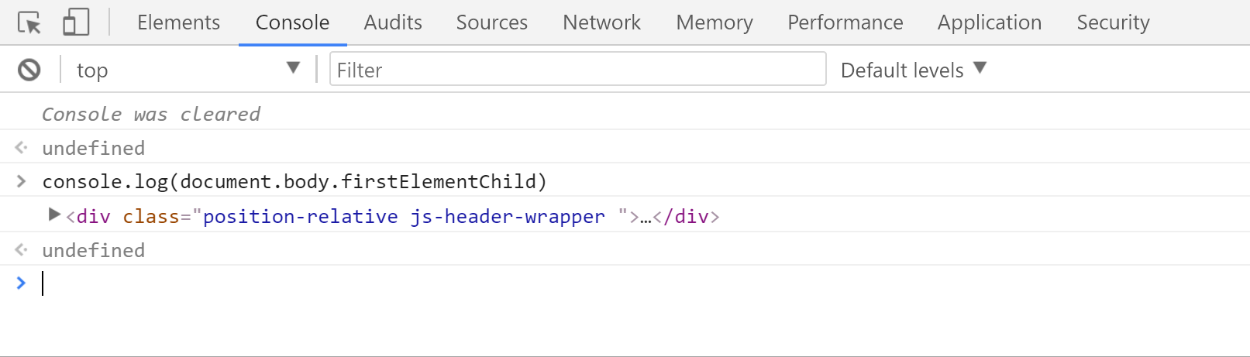
introductions
why section?
class info
javascript tutorial
Console
Chrome:
Right click → Inspect Element or
command + alt + i (Mac) or ctrl + shift + i (Windows)
Notes:
fun tool to help you debug things, lets u run javascript on any webpage

Slide 25
introductions
why section?
class info
javascript tutorial
funzo assignment time
Let’s put your knowledge to the test by making a program that helps your friends feel better!
Copy the code at bit.ly/cssgnicebot into a repl.it and fill in the code for saySomethingNice, upliftingQuote, inspiringQuote, and soothingQuote.
Notes:
fun tool to help you debug things, lets u run javascript on any webpage

Slide 26
Remainder of the Class
Attendance Checkoff
Helpful Resources to Reference/Download!
Optional: Github Overview/Tutorial
Notes:
fun tool to help you debug things, lets u run javascript on any webpage

Slide 27
Attendance Checkoff
bit.ly/cs106s-checkoff-1
(don’t forget to do this! ☺ )
Notes:
fun tool to help you debug things, lets u run javascript on any webpage

Slide 28
Resources
Notes:
fun tool to help you debug things, lets u run javascript on any webpage

Slide 29
Class Resources
Download Python 2.7
^^ required for policing data visualization assignment
Notes:
fun tool to help you debug things, lets u run javascript on any webpage

Slide 30
Editors (IDE’s)
Sublime Text
TextEdit also works!
Honestly anything that lets you edit .txt files, you can use ☺
Notes:
fun tool to help you debug things, lets u run javascript on any webpage

Slide 31
Next Week:
Cancer Diagnosis Assignment! (K-Nearest Neighbors)
Notes:
fun tool to help you debug things, lets u run javascript on any webpage

Slide 32
See you next time, friends!

